Slide 1
Life Insurance Details
1008
My First Real Project
2025
SETHURAMAN C | 2400867 | INTISG25MF001

Slide 2
Contents
Introduction
Requirements
Hierarchy
Procedure
Report
Conclusion

Slide 3
Introduction
1008 – ALLIANZ INSURANCE COMPANY – LIFE INSURANCE
Allianz Insurance Company is a leading insurance company in India.
It offers various types of Policies for its customers.
Due to large amount of data, the insurance company plans to automate it processes.
For this purpose it needs to store all the details in different databases like Policy Database, Agent Database, and Customer Database etc.
So, the main objective of this project is to store the life insurance policy details in the database system.

Slide 4
Requirements
To create a PREMIUM Table and insert with validated records from input file.
To create an ERROR (PS) File that contains all invalid records with the specific reason.
To create a MASTER VSAM (KSDS) File that contains all the entry records.
To create a PREMIUM (PS) File with the records inserted from the table.
To sort PREMIUM records and put them into 2 different SORT (PS) Files.
SORT 1 (PS) → Policy Amount <= 8000
SORT 2 (PS) → Policy Amount > 8000
To create GDG generations of limit 7 for all the files handled.
To create a REPORT (PS) File based on the MASTER VSAM file records with appropriate page break sections.

Slide 5

Flowchart
Flowchart

Slide 6
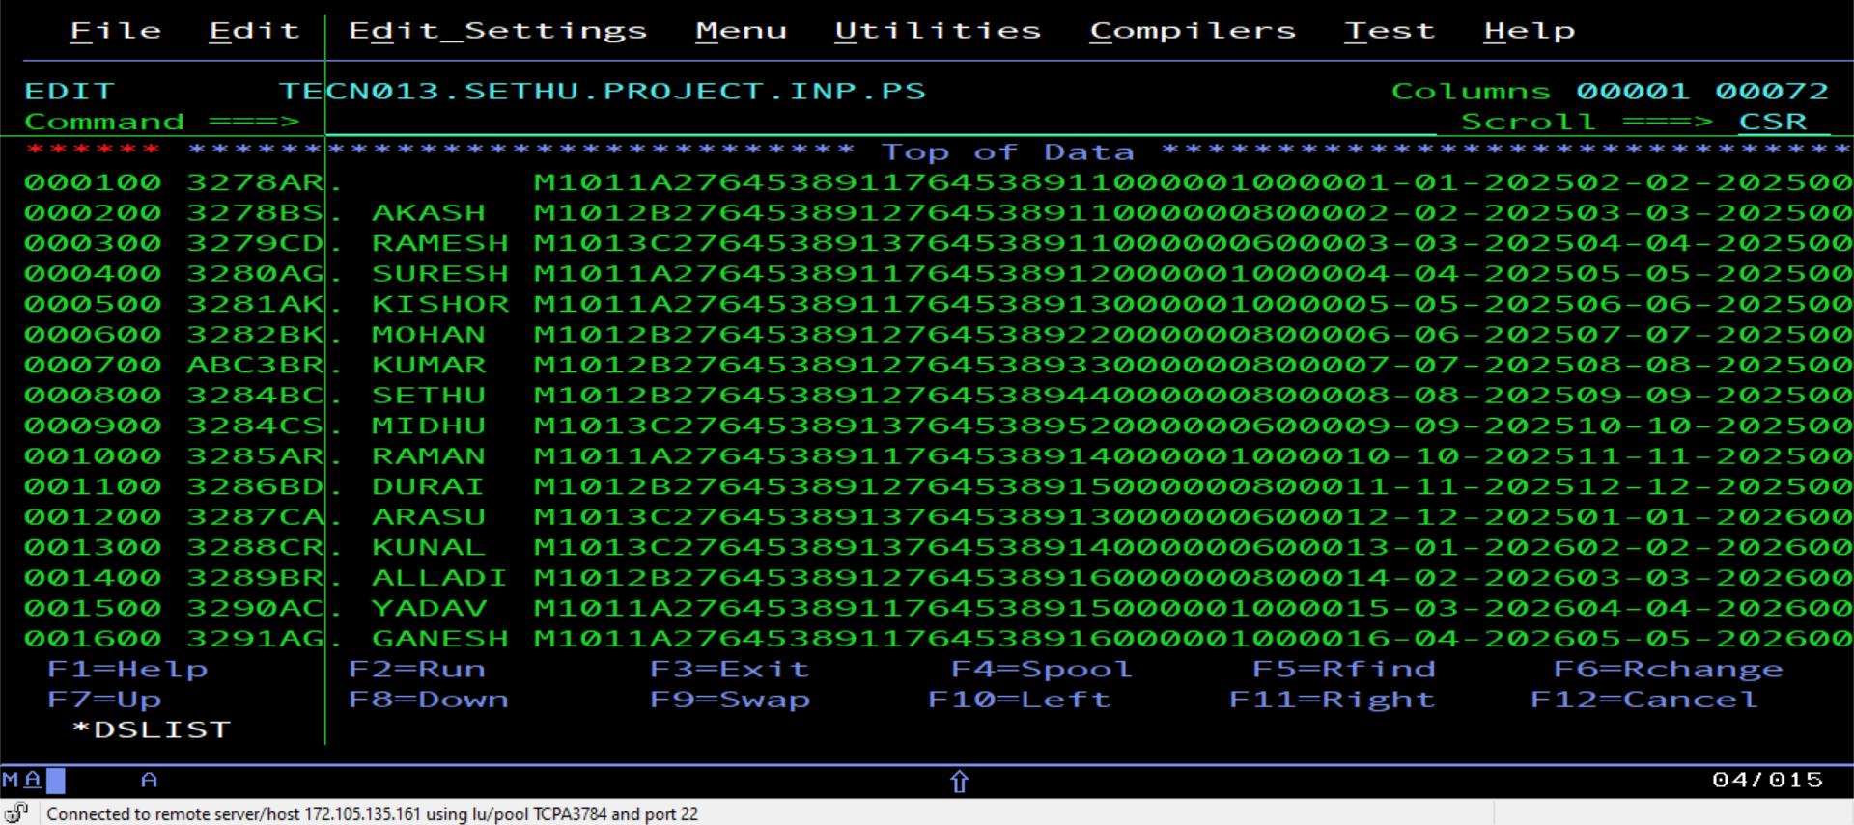
Procedure
1. Reading Records from INPUT (PS) File
Input File – TECN013.SETHU.PROJECT.INP.PS

Slide 7
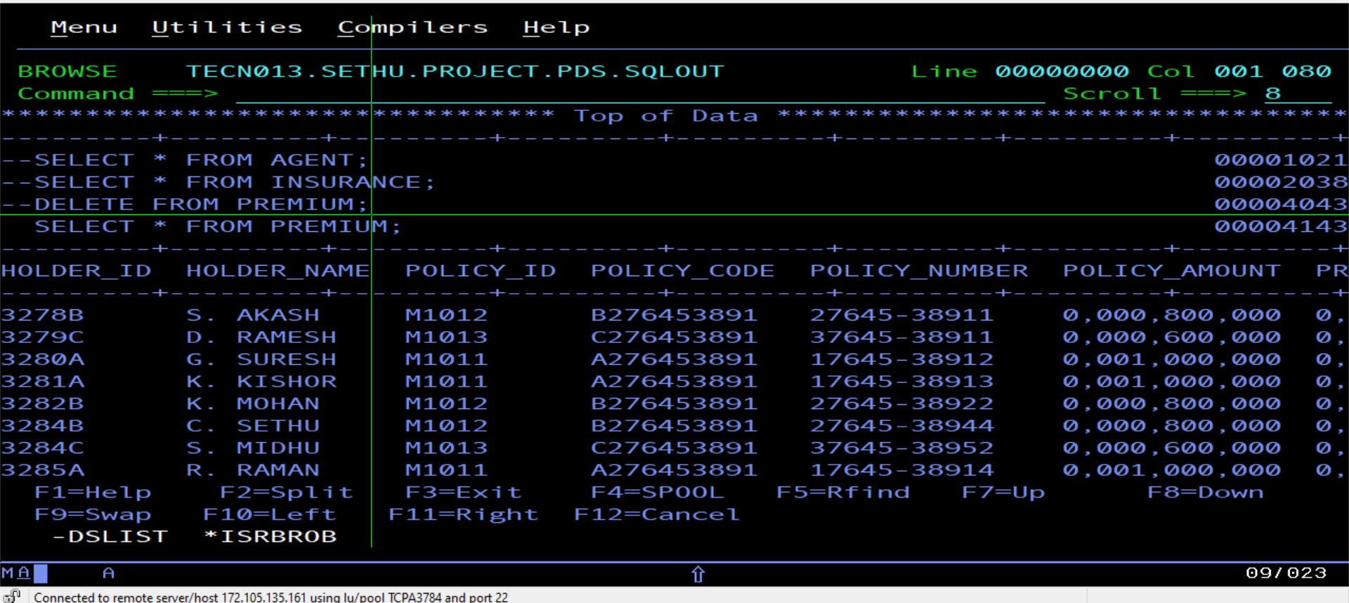
Procedure
2. Insert Validated Records to PREMIUM Table
Input Table – PREMIUM

Slide 8
Procedure
2. Insert Validated Records to PREMIUM Table
Input Table – PREMIUM

Slide 9
Procedure
3. Insert Invalid Records to ERROR (PS) File
Error File – TECN013.SETHU.PROJECT.OUT.ERR

Slide 10
Procedure
4. Entry all the Validated Records in a MASTER VSAM (KSDS) File
Master VSAM Output File – TECN013.SETHU.PROJECT.OUT.KSDS

Slide 11
Procedure
5. Entry the same as well in PREMIUM (PS) File
Output File – TECN013.SETHU.PROJECT.OUT.PS

Slide 12
Procedure
6. Sort the Output File based on Premium Amount
Policy Amount <= 8000 → Sort File – TECN013.SETHU.PROJECT.OUT.PS1

Slide 13
Procedure
6. Sort the Output File based on Premium Amount
Policy Amount > 8000 → Sort File – TECN013.SETHU.PROJECT.OUT.PS2

Slide 14
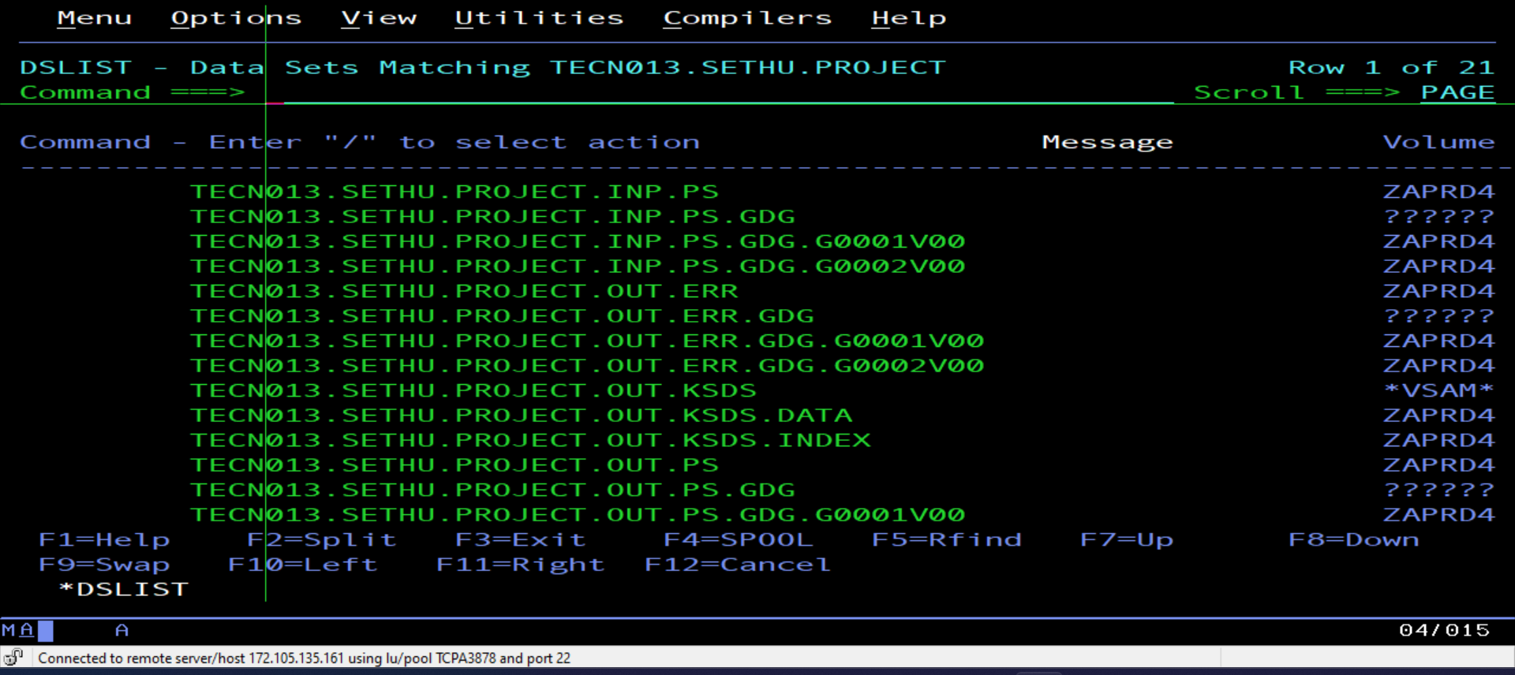
Procedure
7. Create GDG of 7 Generations for all the files handled
GDG Generations – Limit 7

Slide 15
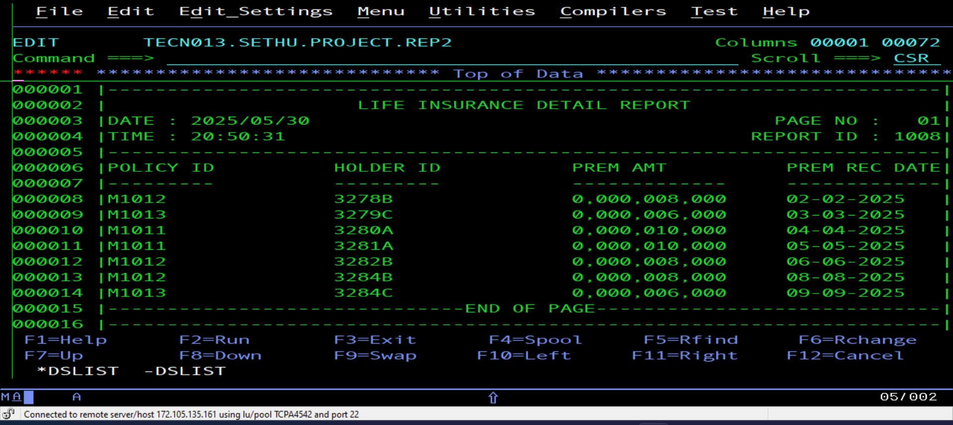
Report
Create a Report File (PS) by taking all the Records from MASTER VSAM (KSDS) File
Report File – TECN013.SETHU.PROJECT.REP2

Slide 16
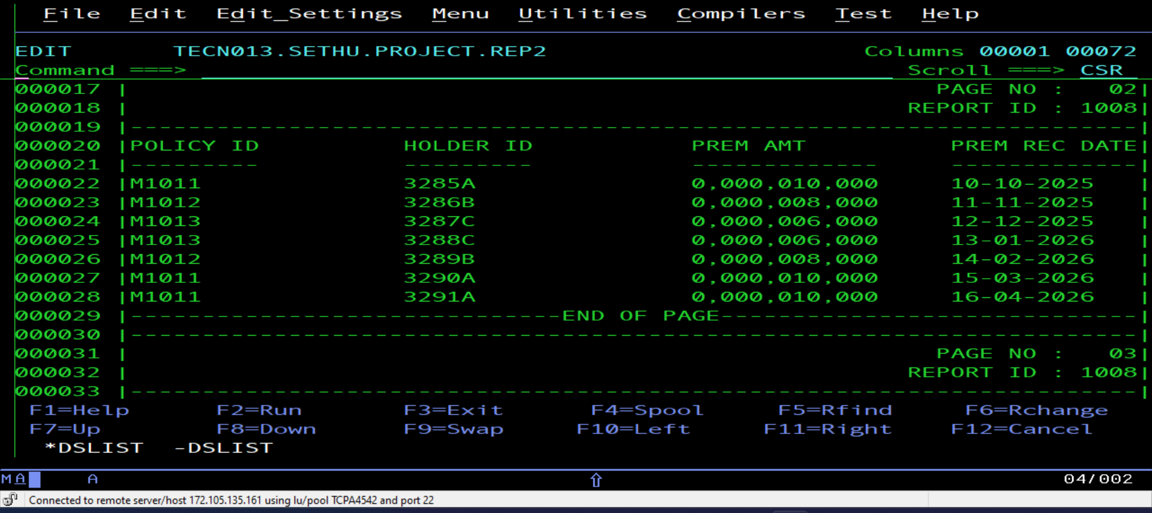
Report
Create a Report File (PS) by taking all the Records from MASTER VSAM (KSDS) File
Report File – TECN013.SETHU.PROJECT.REP2

Slide 17
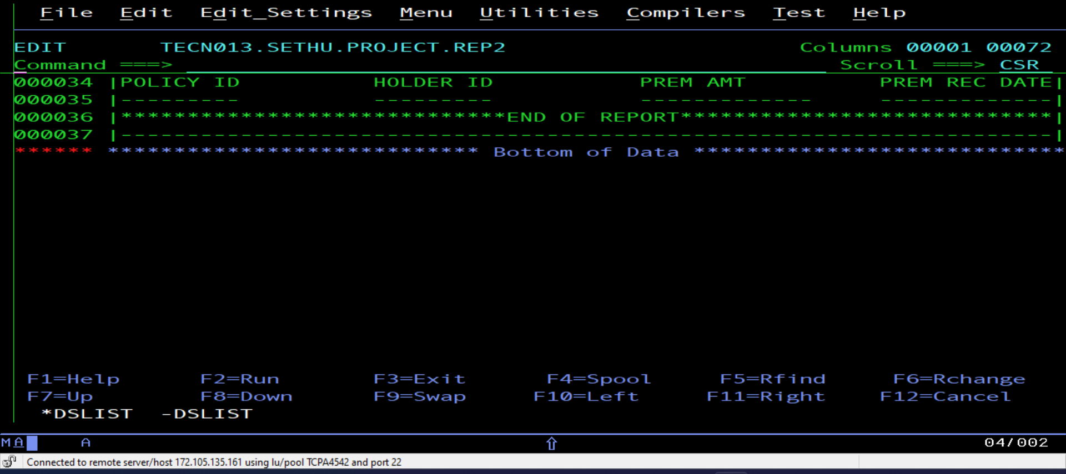
Report
Create a Report File (PS) by taking all the Records from MASTER VSAM (KSDS) File
Report File – TECN013.SETHU.PROJECT.REP2

Slide 18
Conclusion
ALLIANZ INSURANCE COMPANY – LIFE INSURANCE
Enhanced Efficiency and Accuracy: Automation will streamline operations and reduce manual errors.
Structured Databases: Implementation of databases for policies, agents, and customers.
Robust Validation Mechanisms: Ensuring data integrity through validation and error handling.
Segregation of Premium Details: Splitting premium details based on policy amounts for better management.
Master Premium VSAM KSDS File: Inclusion of all the premium details for improved data accessibility.
Detailed Reports: Generation of reports with page break logic for clear information.
Backup in GDG Files: Maintaining backups to ensure data integrity and availability.
Overall Goal: Creating a reliable system for managing insurance policy details, contributing to improved customer service and operational excellence.

Slide 19
Thank You…!!!

